Slide 1


Slide 2
Summary
A human puts boxes on Conveyor belt (powered by Induction motor)
One box goes towards the robotic arm
Blocker blocks other boxes until previous box is placed on the required conveyor belt
Scanner scans the pin code using Pytesseract OCR.
Robotic arm places the box on the designated pincode conveyor belt
Blocker opens its wall and the process continues

Slide 3

Estimated Cost
Product | Quantity | Cost per item(Rs.) | Amount(Rs.)
Conveyor Belt | 200m | 500/m | 100000
AC Motor | 4 | 5000 | 20000
Robotic Arm | 1 | 5000 | 5000
Scanner (Camera, Raspberry Pi, Wires) | 1 | 1365, 3000, 180) | 4544
Total Amount: 129544

Slide 4

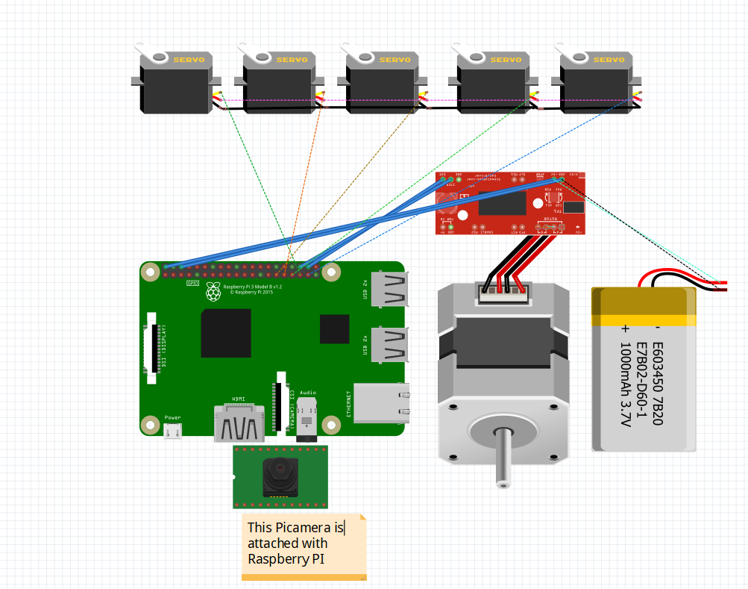
Circuit Diagrams

Slide 5
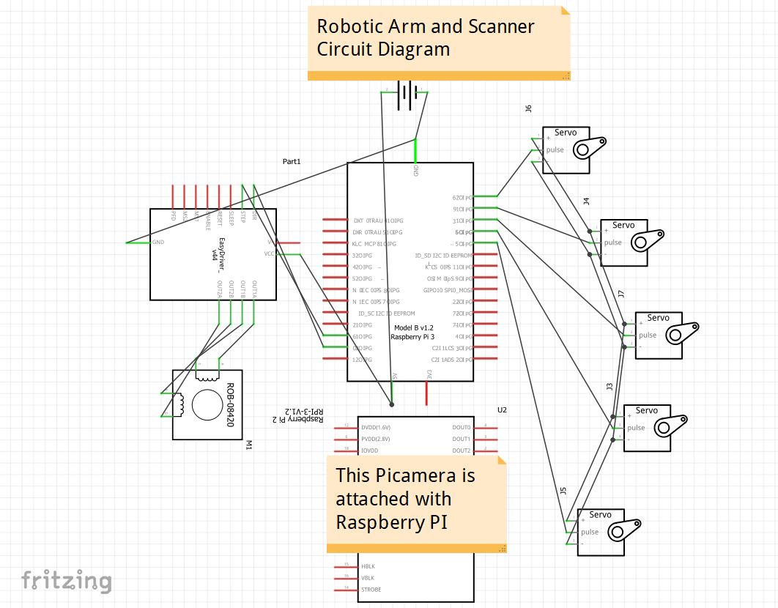

Slide 6
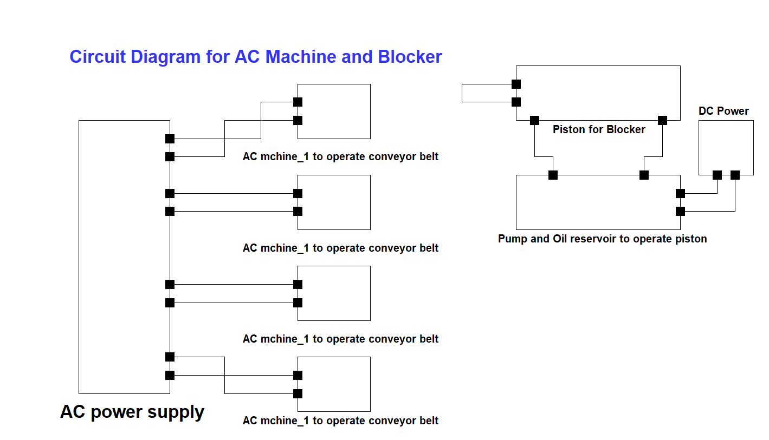

Slide 7

Mentor: Manish Sharma
Mentees:
Dipanshu Rohan Raj Kansal
Akash Karnataka Ayush Singh Vardhan
Mayank Jindal Mohit Samant
Sahas Goyal

